Slide 1

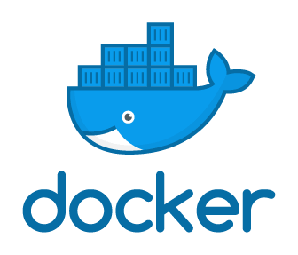
(BCSE 0456) DevOps
Container vs. Virtual Machines
Lecture: 3

Slide 2
AGENDA
Docker File
Docker Images
Docker Containers
Docker Hub
Dockerization Vs. Virtualization

Slide 3
DOCKER CONTAINERS
Standardized packaging for software and dependencies
Isolate apps from each other
Share the same OS kernel
Works for all major Linux distributions
Containers native to Windows Server 2016

Slide 4
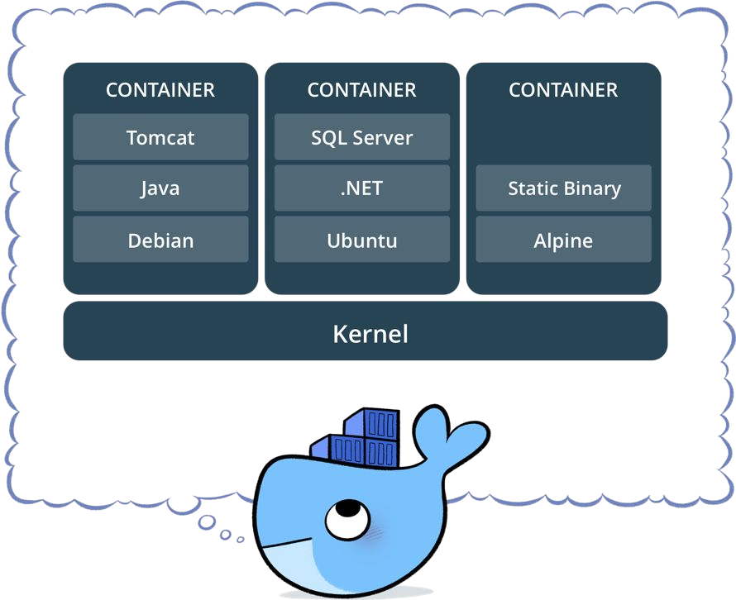
DOCKER CONTAINERS

Slide 5
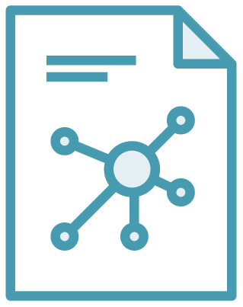
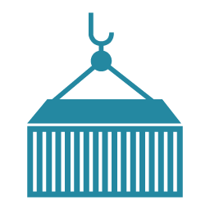
DOCKER CONTAINERS
Docker Image
Docker Container
Example: Ubuntu with Node.js and Application Code
Created by using an image. Runs your application.

Slide 6
DOCKER CONTAINERS ARE NOT VMS
Easy connection to make
Fundamentally different architectures
Fundamentally different benefits.

Slide 7
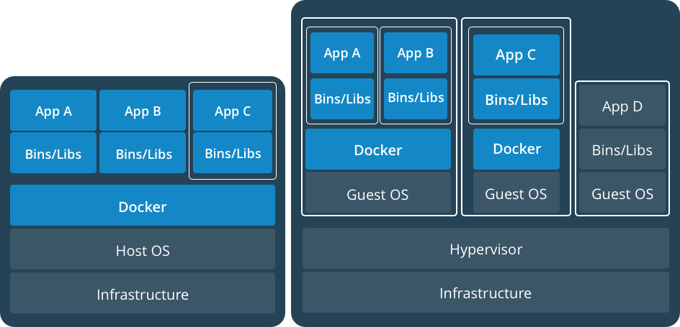
DOCKER CONTAINERS ARE NOT VMS
App 1
App 2
Bins/Libs
Bins/Libs
Guest OS
Guest OS
App 1
App 2
Bins/Libs
Bins/Libs
Hypervisor
Docker Engine
Host Operating System
Host Operating System
Virtual Machines
Docker Containers

Slide 8
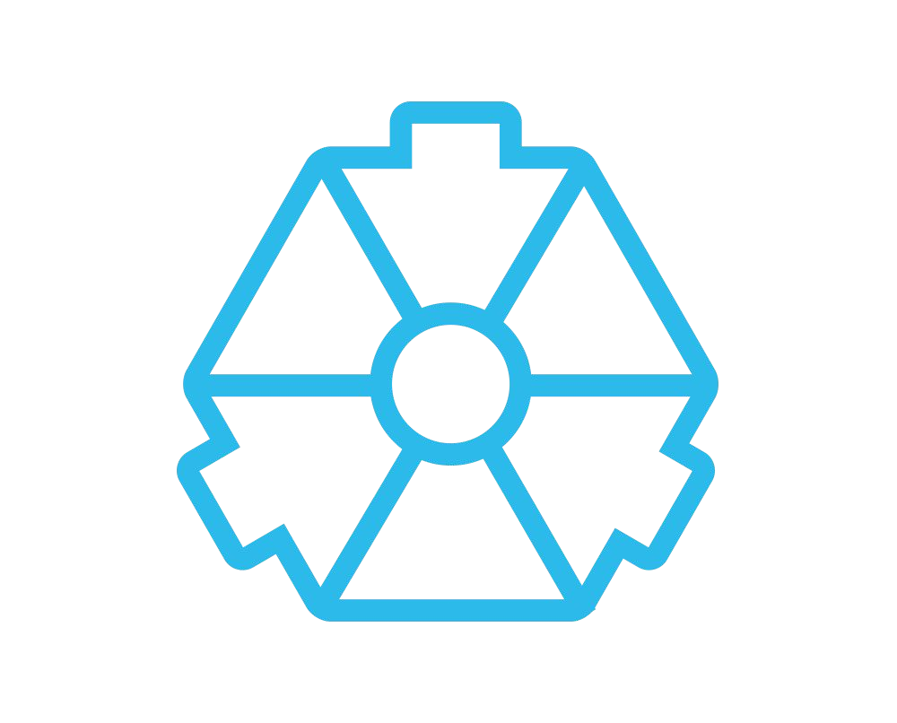
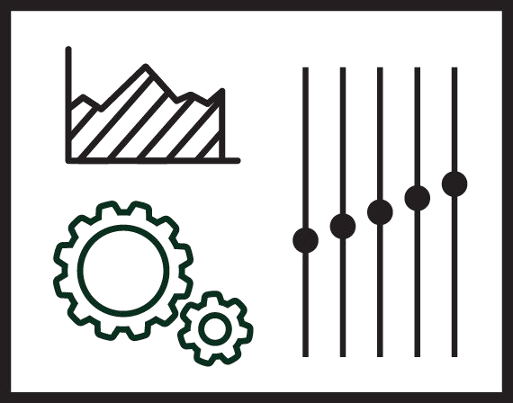
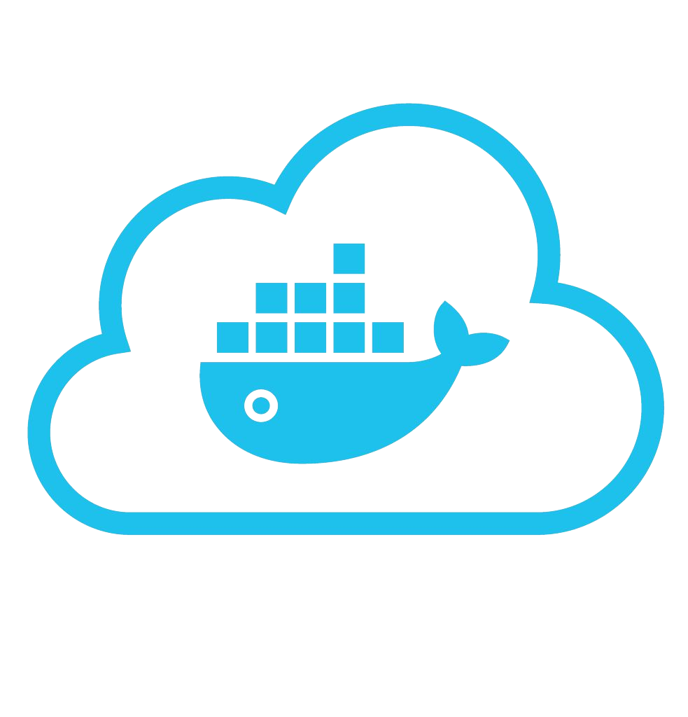









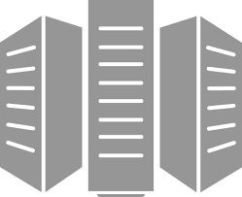



USING DOCKER: BUILD, SHIP, RUN WORKFLOW
Developers IT Operations
BUILD
Development Environments
SHIP
Create & Store Images
RUN
Deploy, Manage, Scale

Slide 9




SOME DOCKER VOCABULARY
Docker Image
The basis of a Docker container. Represents a full application
Docker Container
The standard unit in which the application service resides and executes
Docker Engine
Creates, ships and runs Docker containers deployable on a physical or virtual, host locally, in a datacenter or cloud service provider
Registry Service (Docker Hub (Public) or Docker Trusted Registry(Private))
Cloud or server based storage and distribution service for your images

Slide 10
DOCKER CONTAINERS ARE NOT VMS
Lightweight, open, secure platform.
Simplify building, shipping, running apps.
Runs natively on Linux or Windows Server.
Runs on Windows or Mac Development machines (with a virtual machine).
Relies on "images" and "containers“.

Slide 11
DOCKER CONTAINERS
Docker is a container platform it will be very useful if we understand containerization vs virtualization.

Slide 12
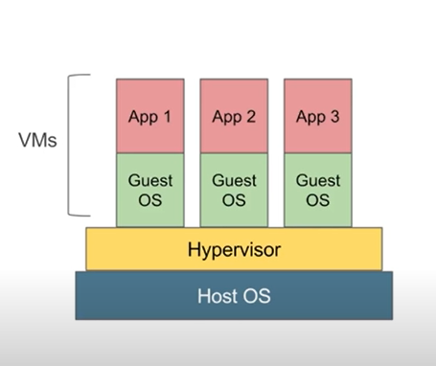
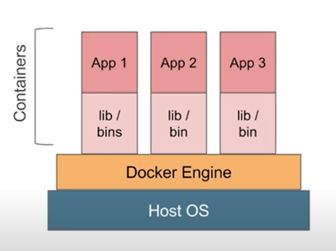
CONTAINERS VS. VIRTUAL MACHINES

Slide 13
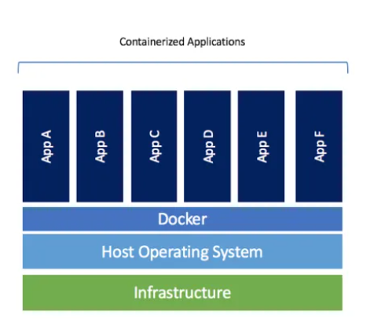
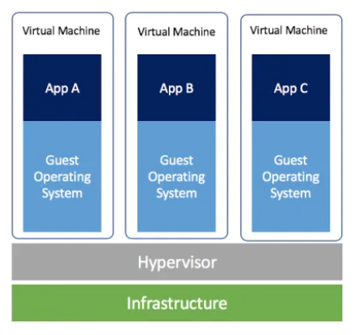
CONTAINERS VS. VIRTUAL MACHINES

Slide 14
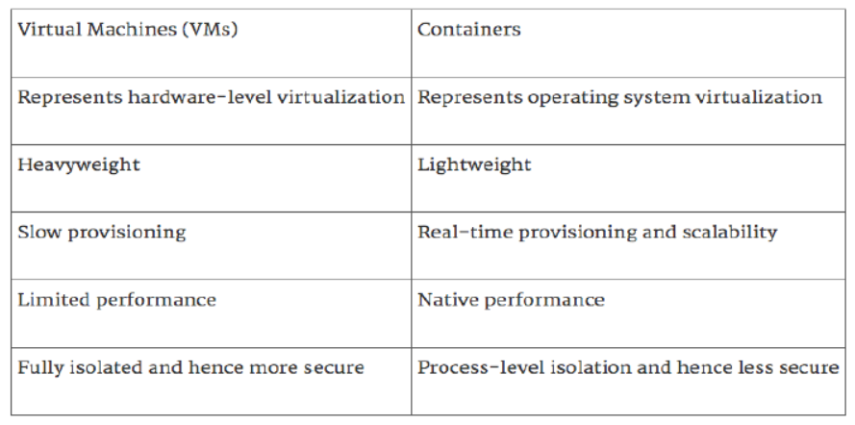
CONTAINERS VS. VIRTUAL MACHINES

Slide 15
ARE CONTAINERS REPLACING VIRTUAL MACHINES?
Containers Are More Agile than VMs.
Containers Enable Hybrid and Multi-Cloud Adoption.
Integrate Containers with Your Existing IT Processes.
Containers Save on VM Licensing.

Slide 16
WHAT ABOUT SECURITY?
Containers are inherently secure on their own.
Docker containers create isolation layers between applications and host and reduce the host surface area which protects both the host and the co-located containers by restricting access to the host.

Slide 17
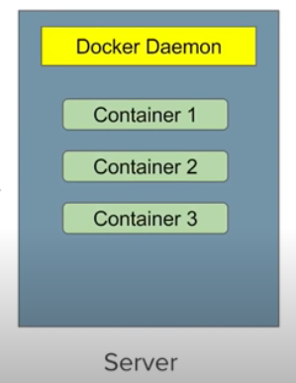
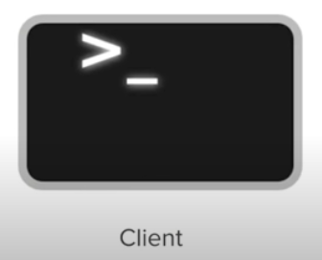
DOCKER CONTAINERS

Slide 18
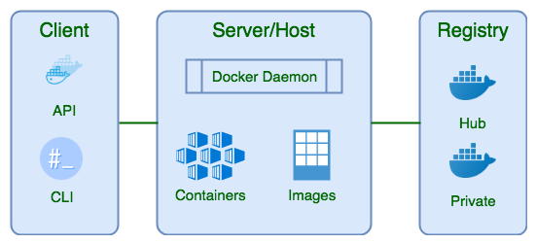
DOCKER ARCHITECTURE

Slide 19
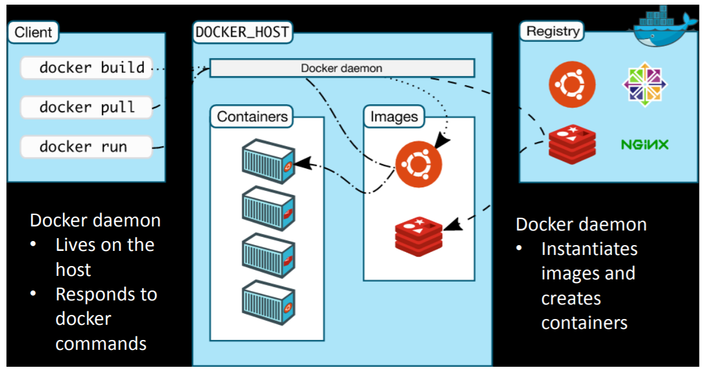
DOCKER ARCHITECTURE

Slide 20
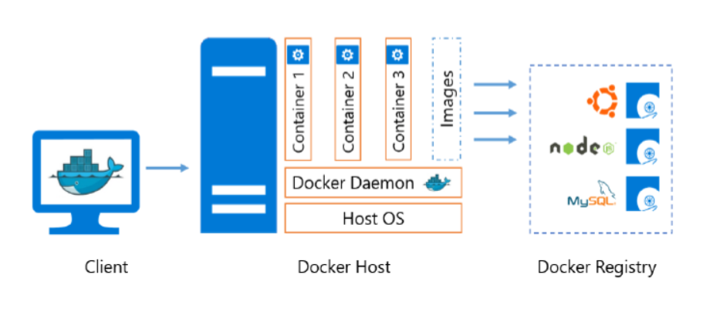
DOCKER ARCHITECTURE

Slide 21


